Slide 1


An Autonomous Institute
Affiliated to VTU, Belagavi,
Approved by AICTE, New Delhi,
Recognized by UGC with 2(f) & 12(B)
Accredited by NBA & NAAC
DEPARTMENT OF COMPUTER SCIENCE ENGINEERING
SUBJECT CODE : MVJ22CS33
SUBJECT NAME: DIGITAL DESIGN AND COMPUTER ORGANIZATION
LECTURE PRESENTATION MODULE – 5
FACULTY : Prof. Nivedita Sahoo, Asst. Prof, Dept. of CSE
An Autonomous Institution ,Affiliated to Visvesvaraya Technological University, Belagavi. Approved By AICTE, New Delhi. Recognized by UGC with 2(f) & 12(B) status. Accredited by NBA and NAAC.

Slide 2
Syllabus for Course
Module 5
Basic Processing Unit: Some Fundamental Concepts: Register Transfers, Performing ALU operations, fetching a word from Memory, storing a word in memory. Execution of a Complete Instruction, Pipelining : Basic concepts, Role of Cache memory, Pipeline Performance
Activity: Show the possible control sequence for implementing any instruction for a single bus organisation.

Slide 3

Module 5 Structure
Basic Processing Unit
Some Fundamental Concepts,
Execution of a Complete Instruction,
Pipelining , Basic concepts,
Role of Cache memory,
Pipeline Performance
.

Slide 4
Reference Books
Carl Hamacher, ZvonkoVranesic, SafwatZaky: Computer Organization, 5th Edition, 2000.
David A. Patterson, John L. Hennessy: Computer Organization and Design – The Hardware / Software Interface ARM Edition, 4th Edition, Elsevier, 2009.
William Stallings: Computer Organization & Architecture, 7th Edition, PHI, 2006.
Vincent P. Heuring& Harry F. Jordan: Computer Systems Design and Architecture, 2nd Edition, Pearson Education, 2004.

Slide 5
Course Outcomes
After studying this course, students will be able to:
Explain the basic organization of a computer system.
Familiarization with various addressing modes and instruction.
Explain different ways of accessing an input / output device including interrupts.
Illustrate the organization of different types of semiconductor and other secondary storage memories.
Illustrate simple processor organization based on hardwired control and micro programmed control and Pipelining.
An Autonomous Institution ,Affiliated to Visvesvaraya Technological University, Belagavi. Approved By AICTE, New Delhi. Recognized by UGC with 2(f) & 12(B) status. Accredited by NBA and NAAC.

Slide 6
Bridge content
D flip flop
Multiplexer
Tri state buffer
Traditional pipeline concept
An Autonomous Institution ,Affiliated to Visvesvaraya Technological University, Belagavi. Approved By AICTE, New Delhi. Recognized by UGC with 2(f) & 12(B) status. Accredited by NBA and NAAC.

Slide 7
Recalling Concepts
Instruction Set Processor (ISP) –executes machine instructions and coordinates the activities of other cells.
⚫ Also called Central Processing Unit (CPU)
A typical computing task consists of a series steps specified by a sequence of machine instructions that constitute a program.
An instruction is executed by carrying out a sequence of more rudimentary operations.

Slide 8
Fundamental Concepts
Processor fetches one instruction at a time and performs the operation specified.
Instructions are fetched from successive memory locations until a branch or a jump instruction is encountered.
Processor keeps track of the address of the memory location containing the next instruction to be fetched using Program Counter (PC).
After fetching an instruction, the contents of the PC are updated to point to the next instruction in the sequence.
⚫ A branch instruction may load a different value into the PC.

Slide 9
Steps in Executing an Instruction
Fetch the contents of the memory location pointed to by the PC. The contents of this location are loaded into the instruction register IR (fetch phase).
IR ← [[PC]]
Assuming that the memory is byte addressable, increment the contents of the PC by 4 (fetch phase).
PC ← [PC] + 4
Carry out the actions specified by the instruction in the IR (execution phase).

Slide 10

Processor Organization
Internal processor bus
Control signals
PC
Instruction decoder and control logic
Address lines
MDR HAS TWO INPUTS AND TWO OUTPUTS
MAR
Memory bus
Data lines
MDR
IR
Datapath
Y
Constant 4
R0
Select
MUX
Add
A
B
ALU
control lines
Sub
R (n – 1)
ALU
XOR
Carry-in
TEMP
Z
Carl Hamacher, ZvonkoVranesic, SafwatZaky: Computer Organization, 5th Edition, 2000.

Slide 11
Processor Organization continue….
Figure shows an organization in which the ALU and all the registers are interconnected via a single common bus.
This bus is internal to the processor.
The data and address lines of the external memory bus are connected to the internal processor bus via the memory data register, MDR, and the memory address register, MAR, respectively.
Register MDR has two inputs and two outputs.

Slide 12
Processor Organization continue....
As instruction execution progresses, data are transferred from one register to another, often passing through the ALU to perform some arithmetic or logic operation.
The instruction decoder and control logic unit is responsible for implementing the actions specified by the instruction loaded in the IR register.
The decoder generates the control signals needed to select the registers involved and direct the transfer of data.
The registers, the ALU, and the interconnecting bus are collectively referred to as the datapath.

Slide 13
Sequence of Steps in Executing an Instruction
Transfer a word of data from one processor register to another or to the ALU.
Perform an arithmetic or a logic operation and store the result in a processor register.
Fetch the contents of a given memory location and load them into a processor register.
Store a word of data from a processor register into a given memory location.

Slide 14
Register Transfers
Instruction execution involves a sequence of steps in which data are transferred from one register to another.
For each register, two control signals are used to place the contents of that register on the bus or to load the data on the bus into the register.
This is represented symbolically in Figure.
The input and output of register Ri are connected to the bus via switches controlled by the signals Ri_{in} and Ri_{out} respectively.

Slide 15
Register Transfers continue..
When Ri_{in} is set to 1, the data on the bus are loaded into Ri.
Similarly, when Ri_{out} is set to 1, the contents of register Ri are placed on the bus.
While Ri_{out} is equal to 0, the bus can be used for transferring data from other registers.

Slide 16



Register Transfers..
Internal processor bus
R i_{in}
R i
Riout
Y in
Y
Constant 4
Select
MUX
A
B
ALU
Z in
Z
Z out
Figure 7.2. Input and output gating for the registers in Figure 7.1.
Carl Hamacher, ZvonkoVranesic, SafwatZaky: Computer Organization, 5th Edition, 2000.

Slide 17
Register Transfers Continue..
Suppose that we wish to transfer the contents of register R1 to register R4.
This can be accomplished as follows:
Enable the output of register R1 by setting R1_{out} to 1. This places the contents of R1 on the processor bus.
Enable the input of register R4 by setting R4_{in} to 1.
This loads data from the processor bus into register R4.
All operations and data transfers within the processor take place within time periods defined by the processor clock.

Slide 18
Register Transfers..
An implementation for one bit of register Ri is shown in Figure as an example.
A two-input multiplexer is used to select the data applied to the input of an edge-triggered D flip- flop.
When the control input Ri_{in} is equal to 1, the multiplexer selects the data on the bus.
⚫ This data will be loaded into the flip-flop at the rising edge of the clock.
When Ri_{in} is equal to 0, the multiplexer feeds back the value currently stored in the flip-flop.

Slide 19
Register Transfers continue..
The Q output of the flip-flop is connected to the bus via a tri-state gate.
When Ri_{out} is equal to 0, the gate's output is in the high-impedance (electrically disconnected) state.
⚫ This corresponds to the open-circuit state of a switch.
When Ri_{out} = 1, the gate drives the bus to 0 or 1, depending on the value of Q.

Slide 20
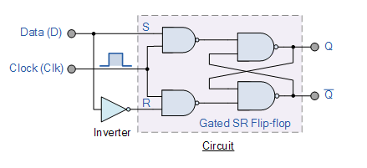
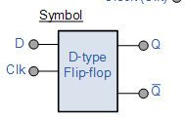
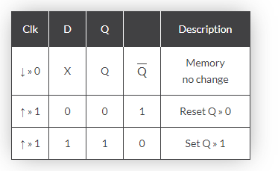
D- Flip flop
The D Flip Flop is by far the most important of the clocked flip-flops as it ensures that ensures that inputs S and R are never equal to one at the same time. The D-type flip flop are constructed from a gated SR flip-flop with an inverter added between the S and the R inputs to allow for a single D (Data) input.
Then this single data input, labeled “D” and is used in place of the “Set” signal, and the inverter is used to generate the complementary “Reset” input thereby making a level-sensitive D-type flip-flop from a level-sensitive SR-latch as now S = D and R = not D as shown
https://www.electronics-tutorials.ws/sequential/seq_4.html

Slide 21
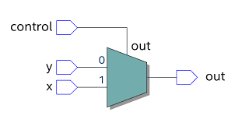
Multiplexer
In electronics, a multiplexer (or mux; spelled sometimes as multiplexor), also known as a data selector, is a device that selects between several analog or digital input signals and forwards it to a single output line. A multiplexer of {\display style 2^{n}} inputs has {\display style n} select lines, which are used to select which input line to send to the output. Multiplexers are mainly used to increase the amount of data that can be sent over the network within a certain amount of time and bandwidth. Multiplexers can also be used to implement Boolean functions of multiple variables.
https://images.app.goo.gl/RsMPbZHdeFoz3tD57

Slide 22
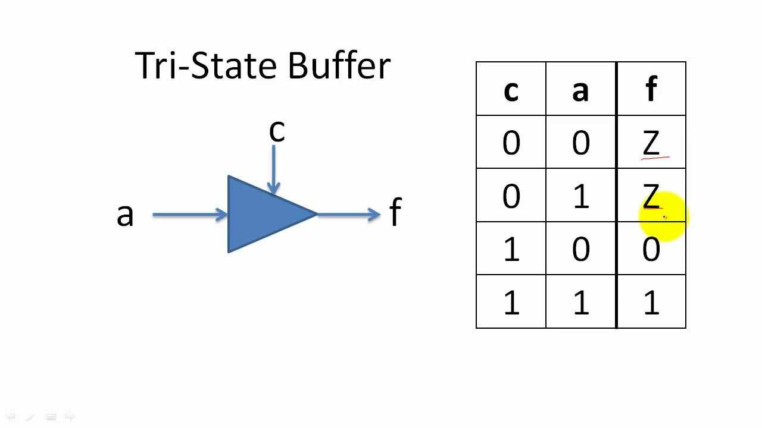
Tri state Buffer
https://images.app.goo.gl/t2RZBuz5NUqmUELd6

Slide 23
Input And Output Gating For One Register Bit.
Carl Hamacher, ZvonkoVranesic, SafwatZaky: Computer Organization, 5th Edition, 2000.
Bus
0
D
Q
1
Q
^{Ri}iout
Ri_{in}
Clock
Figure 7.3. Input and output gating for one register bit.

Slide 24
Performing an Arithmetic or Logic Operation
The ALU is a combinational circuit that has no internal storage.
⚫ It performs arithmetic and logic operations on the two operands applied to its A and B inputs.
ALU gets the two operands from MUX and bus. The result is temporarily stored in register Z.
The sequence of operations to add the contents of register R1 to those of R2 and store the result in R3.
1.
^{R1}out^{, Y}in
2. R2_{out}, SelectY, Add, Z_{in}
3.
^{Z}out^{, R3}in

Slide 25
Performing an Arithmetic or Logic Operation continue..
The signals whose names are given in any step are activated for the duration of the clock cycle corresponding to that step.
⚫ All other signals are inactive.
In step 1, the output of register R1 and the input of register Y are enabled, causing the contents of RI to be transferred over the bus to Y.

Slide 26
Fetching a Word from Memory
To fetch a word of information from memory, the processor has to specify the address of the memory location where this information is stored and request a Read operation.
The information to be fetched may be an instruction in a program or an operand specified by an instruction.
The processor transfers the required address to the MAR, whose output is connected to the address lines of the memory bus.

Slide 27
Fetching a Word from Memory continue..
At the same time, the processor uses the control lines of the memory bus to indicate that a Read operation is needed.
When the requested data are received from the memory they are stored in register MDR,
From MDR, they can be transferred to other registers in the processor.

Slide 28
MDR Connection
Memory-bus data lines
Internal processor bus
^{MDR}outE
MDR_{out}
MDR
MDR_{inE}
MDR_{in}
Connection and control signals for register MDR.
Carl Hamacher, ZvonkoVranesic, SafwatZaky: Computer Organization, 5th Edition, 2000.

Slide 29
Fetching a Word from Memory..
The connections for register MDR are illustrated in previous Figure
It has four control signals:
MDR_{in} and MDR_{out} control the connection to the internal bus.
MDR_{inE} and MDR_{outE} control the connection to the external bus.

Slide 30
Fetching a Word from Memory..
During memory Read and Write operations, the timing of internal processor operations must be coordinated with the response of the addressed device on the memory bus.
The processor completes one internal data transfer in one clock cycle.

Slide 31
Fetching a Word from Memory..
The response time of each memory access varies (based on cache miss, memory-mapped I/O, etc).
To accommodate this, the processor waits until it receives an indication that the requested operation has been completed.
A control signal called Memory-Function-Completed (MFC) is used for this purpose.
The addressed device sets this signal to 1 to indicate that the contents of the specified location have been read and are available on the data lines of the memory bus.

Slide 32
Fetching a Word from Memory..
Consider the instruction Move (R1), R2
The actions needed to execute this instruction are:
MAR ← [R1]
Start a Read operation on the memory bus
Wait for the MFC response from the memory
Load MDR from the memory bus
R2 ← [MDR]

Slide 33
Fetching a Word from Memory..
⚫ The memory read operation requires three steps, which can be described by the signals being activated as follows:
R1_{out}, MAR_{in}, Read
MDR_{inE}, WMFC
MDR_{out}, R2_{in}

Slide 34
Timing
Step
1
2
3
Clock
 |  |  |  |  | ← [R1]
 |  |  |  | MAR
Assume MAR
is always available on the address lines of the memory bus.
MAR
in
Address
Start a Read operation on the memory bus
Read
MR
MDR _{inE}
Data
Wait for the MFC response from the memory
MFC
MDR _{out}
Load MDR from the memory bus
Carl Hamacher, ZvonkoVranesic, SafwatZaky: Computer Organization, 5th Edition, 2000.
R2 ← [MDR]
Figure 7.5.
Timing of a memory Read operation.

Slide 35
Storing a Word in Memory
The desired address is loaded into MAR.
The data to be written are loaded into MDR and a Write command is issued.
Executing the instruction Move R2,(R1) requires the following sequence:
R1_{out}, MAR_{in}
R2_{out}, MDR_{in}, Write
MDR_{outE},WMFC

Slide 36
Execution of a Complete Instruction
Consider the instruction Add (R3), R1
Executing this instruction requires the following actions:
Fetch the instruction
Fetch the first operand (the contents of the memory location pointed to by R3)
Perform the addition
Load the result into R1

Slide 37
Execution of a Complete Instruction..
Add (R3), R1
Step Action
1. PCout, MARin, Read, Select4, Add, Zin
2. Zout, Pcin, Yin, WMFC
3. MDRout, IRin
4. R3out, Yin, WMFC
5. MDRout, SelectY, Add, Zin
6. Zout, R1in, End

Slide 38
Execution of a Complete Instruction..
Figure gives the sequence of control steps required to perform these operations for the single-bus architecture
Steps 1 through 3 constitute the instruction fetch phase,
This is the same for all instructions.
The instruction decoding circuit interprets the contents of the IR at the beginning of step 4.
This enables the control circuitry to activate the control signals for steps 4 through 7, which constitute the execution phase.

Slide 39
Execution of Branch Instructions
A branch instruction replaces the contents of PC with the branch target address
This address is usually obtained by adding an offset X given in the branch instruction, to the updated value of the PC.

Slide 40
Execution of Branch Instructions..
Step Action
1. PCout, MARin, Read, Select4, Add, Zin
2. Zout, PCin, Yin, WMFC
3. MDRout, IRin
4. Offset-field-of-IRout, Add, Zin
5. Zout, PCin, End

Slide 41
Execution of Branch Instructions..
Figure gives a control sequence that implements an unconditional branch instruction.
Processing starts with the fetch phase.
This phase ends when the instruction is loaded into the IR in step 3.
The offset value is extracted from the IR by the instruction decoding circuit, which will also perform sign extension if required.
Since the value of the updated PC is already available in register Y, the offset X is gated onto the bus in step 4, and an addition operation is performed.
The result, which is the branch target address, is loaded into the PC in step 5.

Slide 42
Execution of Branch Instructions..
⚫ The offset X is usually the difference between the branch target address and the address immediately following the branch instruction.
⚫ For example, if the branch instruction is at location 2000 and if the branch target address is 2050, the value of X must be 46.

Slide 43
Execution of Branch Instructions..
Consider now a conditional branch.
In this case, we need to check the status of the condition codes before loading a new value into the PC.
For example, for a Branch-on-negative (Branch <0) instruction, step 4 in Figure is replaced with offset_field_of_IR
Thus, if N = 0 the processor returns to step 1 immediately after step 4.
If N = 1, step 5 is performed to load a new value into the PC, thus performing the branch operation.

Slide 44
Pipelining
Pipelining is widely used in modern processors.
Pipelining improves system performance in terms of throughput.
Pipelined organization requires sophisticated compilation techniques.

Slide 45
Basic Concepts
Making the Execution of Programs Faster
Use faster circuit technology to build the processor and the main memory.
Arrange the hardware so that more than one operation can be performed at the same time.
In the latter way, the number of operations performed per second is increased even though the elapsed time needed to perform any one operation is not changed.

Slide 46
Traditional Pipeline Concept
Laundry Example
Ann, Brian, Cathy, Dave each have one load of clothes to wash, dry, and fold
Washer takes 30 minutes
Dryer takes 40 minutes
“Folder” takes 20 minutes
A
B
C
D
https://images.app.goo.gl/6fCBqzFyQ8BfLYhy5

Slide 47
Traditional Pipeline Concept continue…
6 PM
7
8
9
10
11
Midnight
Time
30
40
20
30
40
20
30
40
20
30
40
20
Sequential laundry takes 6 hours for 4 loads
If they learned pipelining, how long would laundry take?
A
B
C
D
https://images.app.goo.gl/s5K2o9SuGbWkUXEU6

Slide 48
Traditional Pipeline Concept continue…
6 PM
7
8
9
10
11
Midnight
T
a
s
k
O
r
d
e
r
Time
30
40
40
40
40
20
A
Pipelined laundry takes 3.5 hours for 4 loads
B
C
D
https://images.app.goo.gl/zEqFrPopP9jyQmf37

Slide 49
Pipelining
Pipelining is a particularly effective way of organizing concurrent activity in a computer system.
Rather than wait until each instruction is completed, instructions can be fetched and executed in a pipelined manner, as shown in Figure 6.1.
The five stages Fetch, Decode, Compute, Memory, and Write. Instruction Ij is fetched in the first cycle and moves through the remaining stages in the following cycles.
In the second cycle, instruction Ij+1 is fetched while instruction Ij is in the Decode stage where its operands are also read from the register file.
In the third cycle, instruction Ij+2 is fetched while instruction Ij+1 is in the Decode stage and instruction Ij is in the Compute stage where an arithmetic or logic operation is performed on its operands.
Ideally, this overlapping pattern of execution would be possible for all instructions.
Although any one instruction takes five cycles to complete its execution, instructions are completed at the rate of one per cycle.

Slide 50
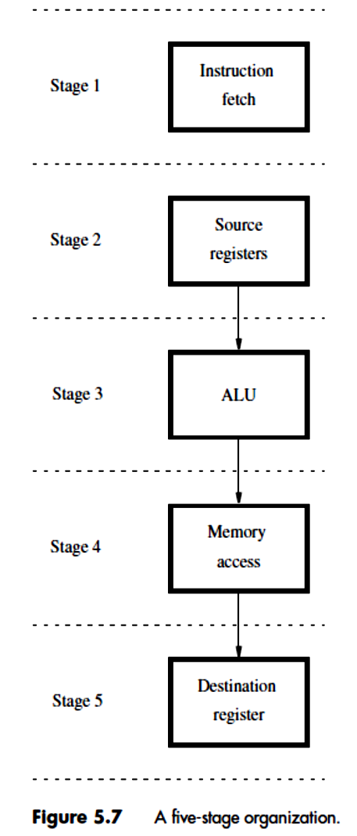

Slide 51
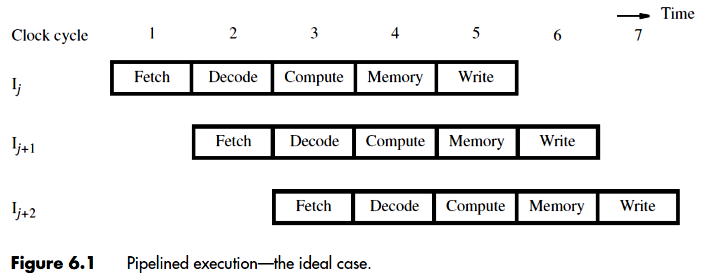

Slide 52
Use the Idea of Pipelining in a Computer
Fetch + Execution
T
ime
I
1
I
2
I
3
T
ime
Clock cycle
1
2
3
4
F
1
E
1
F
2
E
2
F
3
E
3
Instruction
(a) Sequential execution
I
1
F
1
E
1
I
2
F
2
E
2
Interstage buffer
B1
I
3
F
3
E
3
Instruction
Ex
ecution
fetch
unit
(c) Pipelined execution
unit
(b) Hardware organization
Figure 8.1. Basic idea of instruction pipelining.
Carl Hamacher, ZvonkoVranesic, SafwatZaky: Computer Organization, 5th Edition, 2000.

Slide 53
Use the Idea of Pipelining in a Computer….
Fetch + Decode
+ Execution + Write
Carl Hamacher, ZvonkoVranesic, SafwatZaky: Computer Organization, 5th Edition, 2000.

Slide 54
Role of Cache Memory
Each pipeline stage is expected to complete in one clock cycle.
The clock period should be long enough to let the slowest pipeline stage to complete.
Faster stages can only wait for the slowest one to complete.
Since main memory is very slow compared to the execution, if each instruction needs to be fetched from main memory, pipeline is almost useless.
Fortunately, we have cache.

Slide 55
Pipeline Performance
The potential increase in performance resulting from pipelining is proportional to the number of pipeline stages.
However, this increase would be achieved only if all pipeline stages require the same time to complete, and there is no interruption throughout program execution.
Unfortunately, this is not true.

Slide 56
Pipeline Performance continue...
Carl Hamacher, ZvonkoVranesic, SafwatZaky: Computer Organization, 5th Edition, 2000.

Slide 57
Pipeline Performance continue...
The previous pipeline is said to have been stalled for two clock cycles.
Any condition that causes a pipeline to stall is called a hazard.
Data hazard – any condition in which either the source or the destination operands of an instruction are not available at the time expected in the pipeline. So some operation has to be delayed, and the pipeline stalls.
Instruction (control) hazard – a delay in the availability of an instruction causes the pipeline to stall.
Structural hazard – the situation when two instructions require the use of a given hardware resource at the same time.

Slide 58
Pipeline Performance continue...
Instruction hazard
Idle periods – stalls (bubbles)
Carl Hamacher, ZvonkoVranesic, SafwatZaky: Computer Organization, 5th Edition, 2000.

Slide 59
Pipeline Performance continue...
Carl Hamacher, ZvonkoVranesic, SafwatZaky: Computer Organization, 5th Edition, 2000.
Structural hazard
Load X(R1), R2

Slide 60
Pipeline Performance continue...
Again, pipelining does not result in individual instructions being executed faster; rather, it is the throughput that increases.
Throughput is measured by the rate at which instruction execution is completed.
Pipeline stall causes degradation in pipeline performance.
We need to identify all hazards that may cause the pipeline to stall and to find ways to minimize their impact.

Slide 61
NPTEL Links
Basic Operation of computer (Single and multi bus architecture): https://lake.videoken.com/nptel/category/711/search/instruction%20execution/video/K7fnDf-P6_c?tocitem=19
Instruction fetch from memory: https://www.youtube.com/watch?v=JCIRjFh5adQ
Hardwired Controlled Control Unit: https://lake.videoken.com/nptel/category/711/search/Hardwired%20Controlled%20Control%20Unit/video/b5thcNYBrQc?tocitem=8

Slide 62
NPTEL Links
Microprogrammed control unit: https://lake.videoken.com/nptel/category/711/search/COA%20%5BModule%2003%20-%20Lecture%2007%5D:%20Microinstructions%20and%20Microprograms/video/UMqHq_9omr0
Instruction Pipeline and Performance: https://lake.videoken.com/nptel/category/711/search/Instruction%20Pipeline%20&%20Performance%20-%20I/video/-rwmE49WC_I

Slide 63
Innovative content
Hardwired CU vs Micro-programmed CU: https://www.youtube.com/watch?v=A8weMAyF6UM
How instruction is executed:
https://www.futurelearn.com/courses/how-computers-work/0/steps/49284
Bus architecture and how register transfers work - 8 bit register:
https://www.youtube.com/watch?v=QzWW-CBugZo

Slide 64
FDP content
Microprogrammed Control-I
https://www.youtube.com/watch?v=Ru6YeppPA0U
Design of Hardwired controlled Control Unit
https://www.youtube.com/watch?v=b5thcNYBrQc

Slide 65
Self Assessment Question
How register transfer take place in processor ?
What instructions to be followed to read and write data from memory?
How to generated Zin signal?
How End signal is generated?

Slide 66
Quiz questions
1. What does the hardwired control generator consist of? a) Decoder/encoder b) Condition codes c) Control step counter d) All of the mentioned
2. What does the end instruction do? a) It ends the generation of a signal b) It ends the complete generation process c) It starts a new instruction fetch cycle and resets the counter d) It is used to shift the control to the processor

Slide 67
Quiz questions
3. The part of a processor which contains hardware necessary to perform all the operations required by a computer: a) Data path b) Controller c) Registers d) Cache
4. A set of microinstructions for a single machine instruction is called ___________ a) Program b) Command c) Micro program d) Micro command

Slide 68
Quiz questions
5. ___________ is the raw material used as input and __________ is the processed data obtained as output of data processing. a) Data, Instructions b) Instructions, Program c) Data, Program d) Program, Code
6. If the control signals are generated by combinational logic, then they are generated by a type of _______________ controlled unit. a) Micro programmed b) Software c) Logic d) Hardwired

Slide 69
Quiz questions
7. In multiple Bus organization, the registers are collectively placed and referred as ______ a) Set registers b) Register file c) Register Block d) Map registers
8. The main advantage of multiple bus organization over a single bus is _____ a) Reduction in the number of cycles for execution b) Increase in size of the registers c) Better Connectivity d) None of the mentioned

Slide 70
Quiz questions
9. What does MAR stand for? a) Main Address Register b) Memory Access Register c) Main Accessible Register d) Memory Address Register
10. Micro-program consists of a set of microinstructions which are strings of 0s and 1s. a) True b) False
https://docs.google.com/forms/d/1v1vMAwqIXNK1hCTGM74kNbaB4LPFzzIjQvrHhAUYpqk/edit

Slide 71
University paper questions
Q. No. | MODULE- 5 | MARKS | CO Code | Learning Level
1 | Explain the three bus organization of the processor and its advantage. Write control sequence for the instruction MUL R4, R5, R6 | 10 | C205.5 | L3
2 | Discuss the organization of hardwired control. Explain how END signal is generated? | 7 | C205.5 | L2
3 | Discuss the control sequence required to execute the instruction ADD (R3) , R1 | 7 | C205.5 | L2

Slide 72
University paper questions
Q. No. | MODULE- 5 | MARKS | CO Code | Learning Level
4 | With block diagram explain microprogrammed control unit. Also write actions to execute ADD(R3), R1 instuction | 10 | C205.5 | L3
5 | Describe the sequence of control signals to be generated to fetch an instruction from memory in a single bus organization. | 10 | C205.5 | L2
www.vtu.ac.in

Slide 73
Case Study
Study different hardwired control unit design methods.
For multiple bus organization, write control sequence to execute the instruction
SUB R4, R5, R6

Slide 74
Thank You

